Slide 1
US companies’ stocks and ADR are traded.
Indexes for specific stocks are also published.
Ex. NASD (NASDAQ)
DJIA(Dow Jones Industrial Average)
USA
9:30
16:00
0:15
6:30
9:30
a
b
c
9h30m ahead
The previous day’s USA stock market (NYSE)
seems to affect
the next day’s IND stock market (NSE)
A
B
C
15:30
19:00
1:30
9:15
15:30
Indian companies’ stocks are traded.
Ex. INFY (Infosys)
TATA MOTORS
ICICI BANK
IND

Slide 2
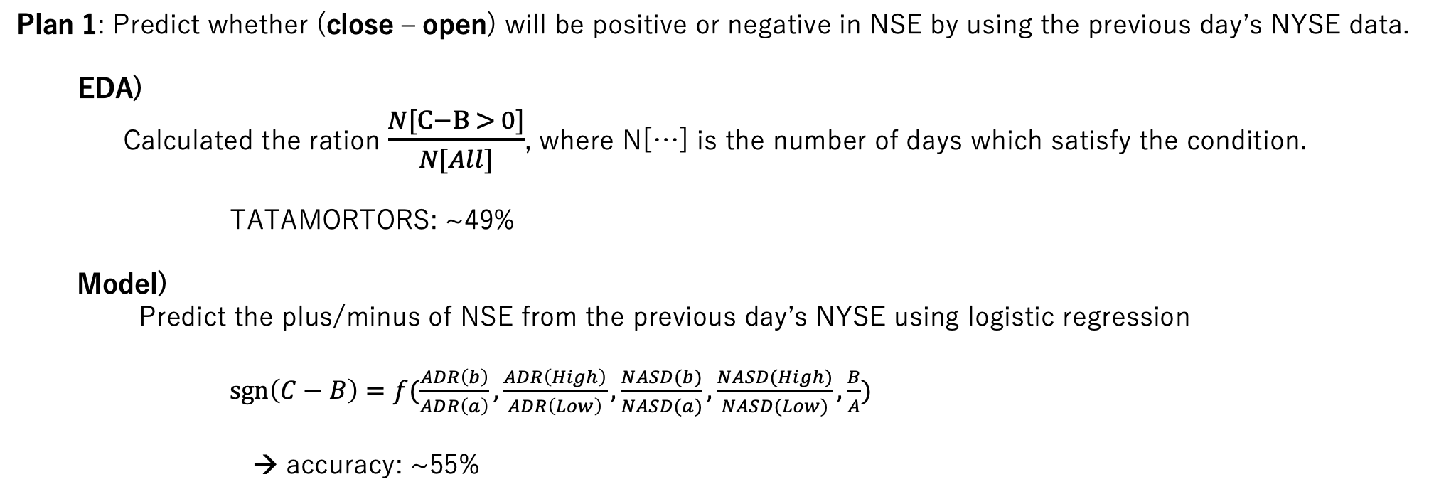
Plan 1: Predict whether (close – open) will be positive or negative in NSE by using the previous day’s NYSE data.
EDA)
Calculated the ration $\frac{N[C−B > 0]}{N[All]}$, where N[…] is the number of days which satisfy the condition.
TATAMORTORS: ~49%
Model)
Predict the plus/minus of NSE from the previous day’s NYSE using logistic regression
$\operatorname{sgn}\left(C−B\right)=f(\frac{ADR\left(b\right)}{ADR\left(a\right)},\frac{ADR\left(High\right)}{ADR\left(Low\right)},\frac{NASD(b)}{NASD(a)},\frac{NASD(High)}{NASD(Low)},\frac{B}{A})$
→ accuracy: ~55%

Slide 3
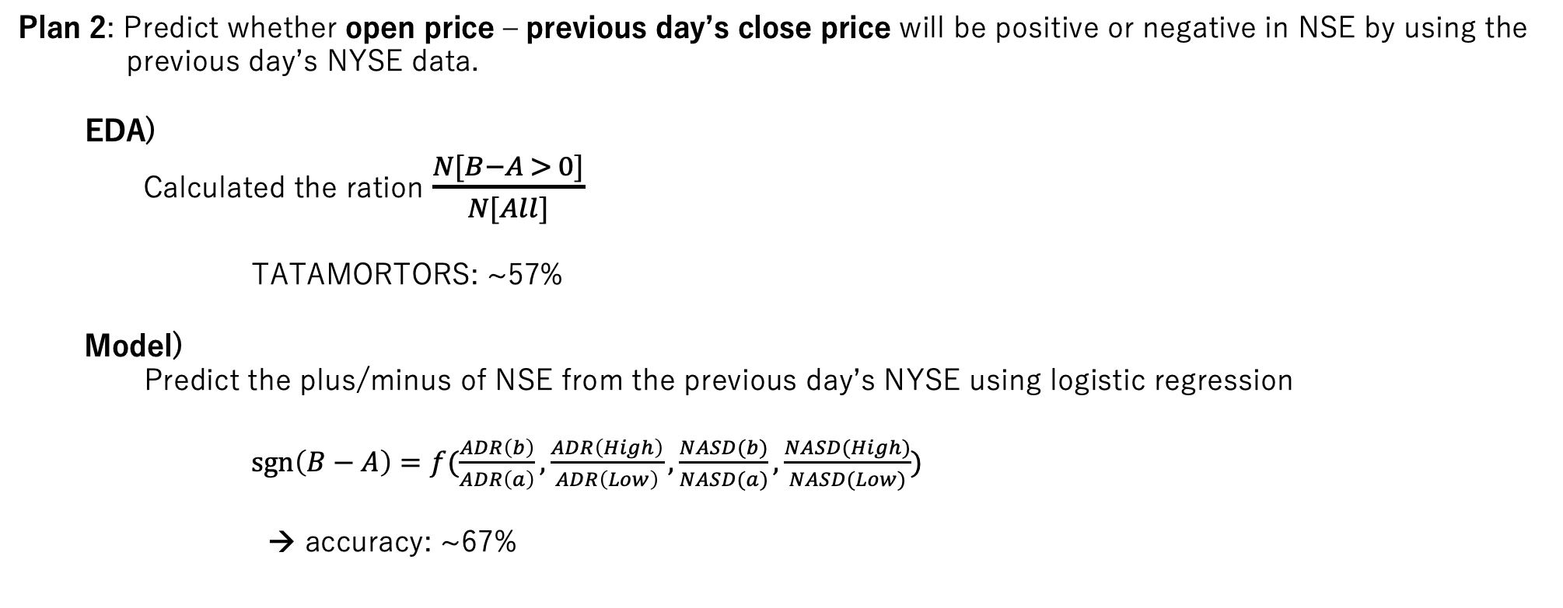
Plan 2: Predict whether open price – previous day’s close price will be positive or negative in NSE by using the previous day’s NYSE data.
EDA)
Calculated the ration $\frac{N[B−A > 0]}{N[All]}$
TATAMORTORS: ~57%
Model)
Predict the plus/minus of NSE from the previous day’s NYSE using logistic regression
$\operatorname{sgn}\left(B−A\right)=f(\frac{ADR\left(b\right)}{ADR\left(a\right)},\frac{ADR\left(High\right)}{ADR\left(Low\right)},\frac{NASD(b)}{NASD(a)},\frac{NASD(High)}{NASD(Low)})$
→ accuracy: ~67%

